Slide 1


Capstone Project
Play Store App Review Analysis
Ajay Pandey
Manjiri Kulkarni
Prasad Wagh
Shahrukh Ahmad

Slide 2
Content:
Problem Statement
Why Google Play Store and it’s data?
EDA and process involved
Data Understanding
Data Cleaning and Manipulations
Correlation Heatmaps
Exploratory Data Analysis(EDA):
Bivariate Analysis
App Categories
App Price
App Ratings
App Installs
App Revenue
Sentiments
Challenges faced during data exploration
Conclusions of our analysis
Predictions

Slide 3

Problem Statement:
The Play Store apps data has enormous potential to drive app-making businesses to success. Actionable insights can be drawn for developers to work on and capture the Android market.
Each app (row) has values for category, rating, size, and more. Another dataset contains customer reviews of the android apps.
Our main objective is to perform EDA on the given dataset to discover key factors responsible for app engagement and success.
We need to analyze the data and come up with meaningful insights that would actually help business to strategize their moves.

Slide 4
Why Google Play Data is important to analyze??
In 2021, the Google Play Store had 70% of worldwide downloads throughout the whole year.
As a large section of apps are free, people tend to download them from Google Play Store.
Mobile app market is set to grow 20% by 2023.
It offers a ready-made market for apps and games. They have a capacity of about a little over 2 billion users monthly!!
Knowing the important insights from the play store data can help developers and business managers because they can predict the profit and manage their revenues accordingly.
So, let’s get started!!

Slide 5
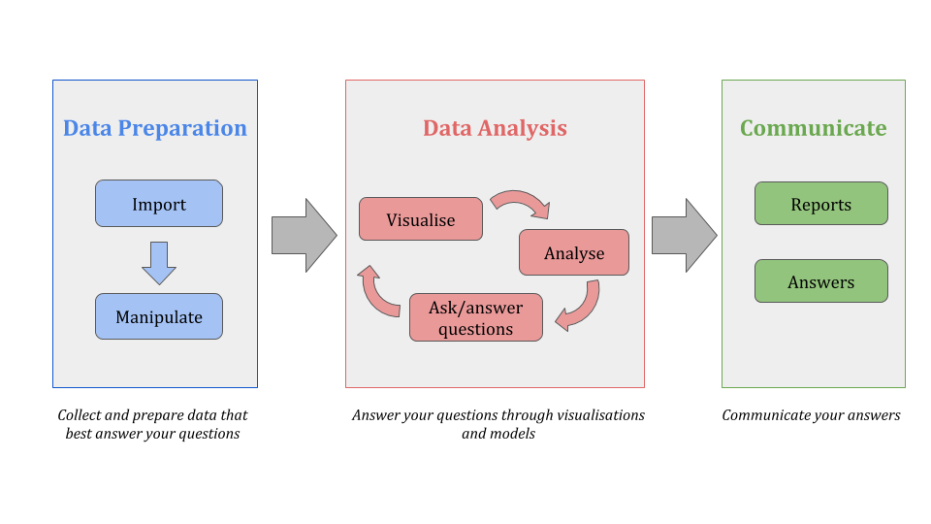
Flowchart And EDA Process:

Slide 6
Exploring our databases:
We have 2 databases: Play store data set + User reviews data set
Play store data set : It contains basic details of the app like number of users, reviews, ratings, etc. It has 10841 rows and 13 columns. The features of play store data are:
App: It contains name of the app with short description.
Category: This column give the category to which an app belongs. This data set contains 33 categories.
Rating: The average rating given by the users for the respective app.
Reviews: The number of users that have dropped a review for this respective app.
Size: The disk space required to install the respective app.

Slide 7
Exploring our databases continued..
Installs: The approximate number of times the respective app was installed
Type: It states whether an app is free to use or paid.
Price: It gives the price payable to install the app. Price is 0 for free app.
Content Rating: It states which age group is suitable to consume the content of the respective app.
Genres: It gives the genres to which respective app belongs.
Last Updated: It gives the date at which the latest update for the respective app was released.
Current Ver: It gives the current version of the respective app.
Android Ver: It gives the android version of the respective app.

Slide 8
Exploring our databases continued..
User reviews data set : It contains the user reviews and its sentiment score for the respective app.
It has 64295 rows and 5 columns.
App: It contains name of the app with short description.
Translated Review: It contains the English translation of the review dropped by the user of the app.
Sentiment: It gives the attitude/emotion of the writer. It can be ‘Positive’ , ‘Negative’ or ‘Neutral’.
Sentiment Polarity: It gives the polarity of the review. Its range is [-1,1], where 1 means ‘Positive statement’ and -1 means a ‘Negative statement’.
Sentiment Subjectivity: This value gives how reviewer’ s opinion is to the opinion of the general public. Its range is [0,1].

Slide 9
Data Cleaning and Manipulation:
In the size column, converted KBs→MBs
02
From the Installs and Price columns, changed ‘$’, ‘,’, ‘+’ to an empty string.
Dropped duplicate rows from both the datasets
01
03
04
In ‘Rating’ column, replaced the null values with the mode.

Slide 10
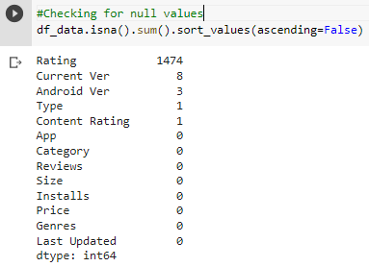
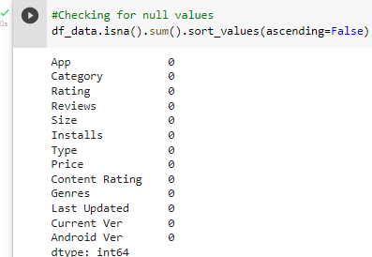
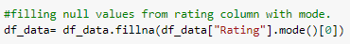
Dealing with Null Values of Play Store Data
There were 5 columns Rating, Current Ver, Android Ver, Type and Content Rating with missing values.

Slide 11
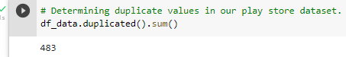

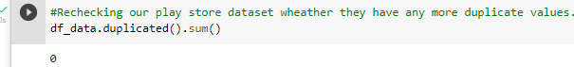
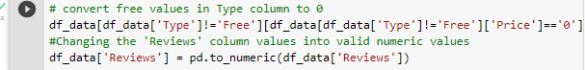
Dealing with Duplicate Values in Play Store Data

Slide 12
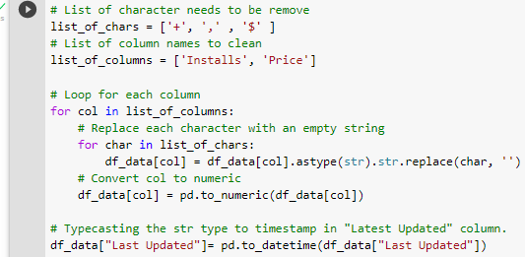

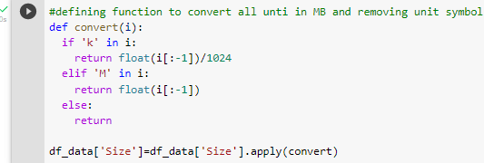

Dealing with Symbolic Values from Price and Installs column

Slide 13
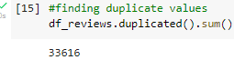

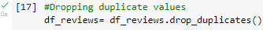
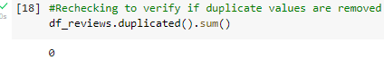
Dealing with Duplicate Values in User Review Data
Now, our data is ready for the analysis!

Slide 14
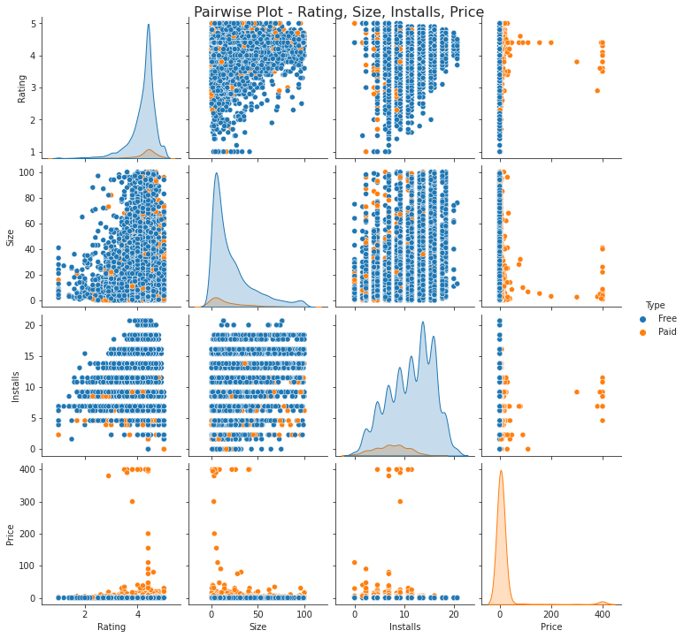
Bivariate Analysis
Here, we are exploring 2 columns at the same time, for the purpose of determining the empirical relationship between them.

Slide 15
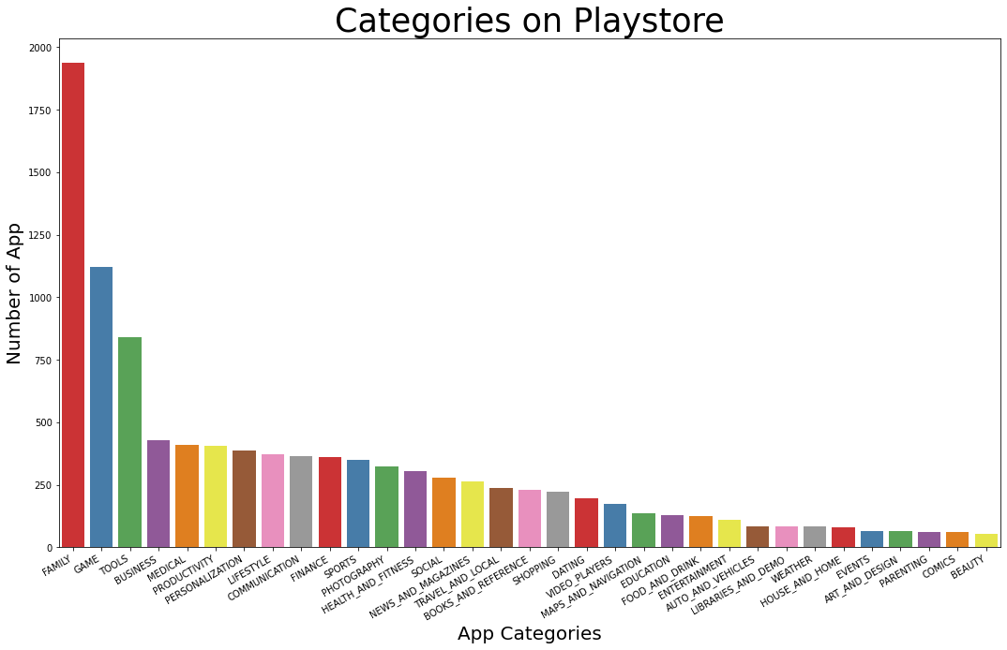
Let’s explore app categories!
Most of the apps are under FAMILY & GAME category and least are of EVENTS & BEAUTY Category.

Slide 16
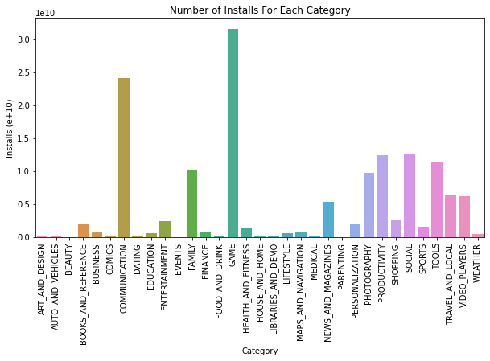
What are the installs across various categories?
Less Preferred
Parenting
Beauty
Preferred
Social
Communication
Game

Slide 17
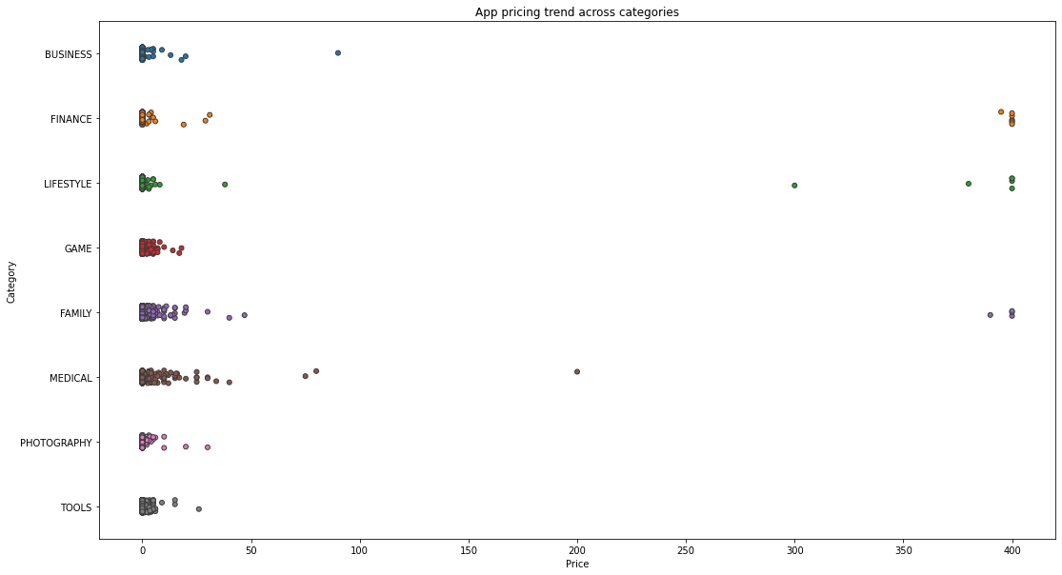

How does the price vary across major categories?
Many factors should be considered while selecting the right pricing for your mobile app. It is important to re-evaluate the app price before entering the market.
Here we can see that different apps categories demand different price ranges. Some apps that are simple and easy are free like tools and games.
All Game apps are comparatively low in price, may be that's the reason game apps have more number of downloads, as we have seen earlier. Hence, Lower the app price → More are the installs!!!

Slide 18
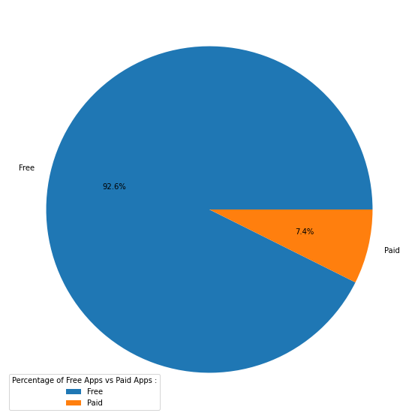
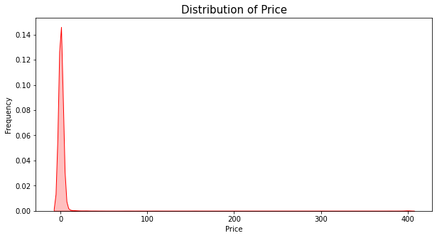
How many apps are paid?
From the above pie chart, we can conclude 92.6% apps on google play store are free.
Even from the 7.4% of paid apps, most of the apps has price range under 100 dollars.
So less the price
More are the installs!!

Slide 19
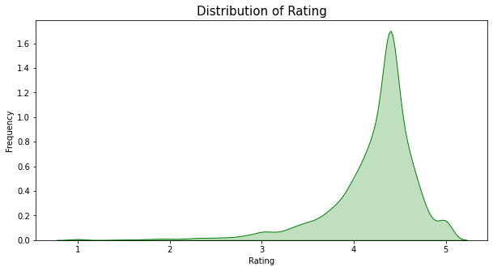
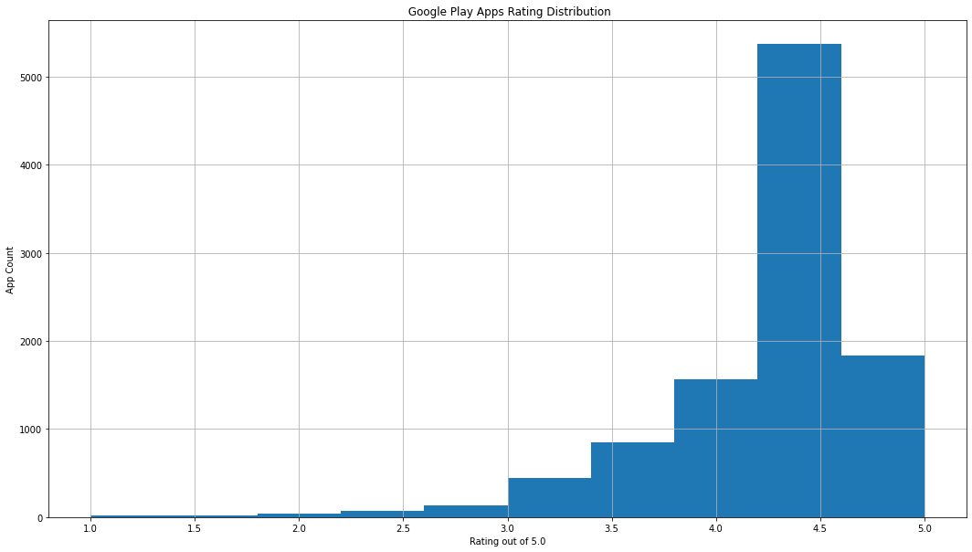
Now let’s see how ratings are performing!
We can observe that average rating across all app categories is 4.217.
A small spike at rating 1 emphasizes that a few apps has been rated poorly and hence the subsequent installs are affected.

Slide 20
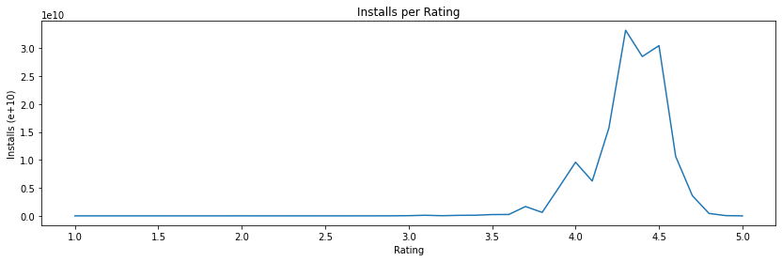
How does installs perform against rating?
Here, we can observe that higher the rating, more the no of installs. But this correlation slightly changes after 4.5 ratings. The probable reason could be
Increase in the size of an app
Increase in the price of an app
One interesting insight is after 4.0, the ratings are slightly dipped. The reason is increase in price! But as soon as the prices are decreased, the ratings are again up.
Price
Ratings

Slide 21
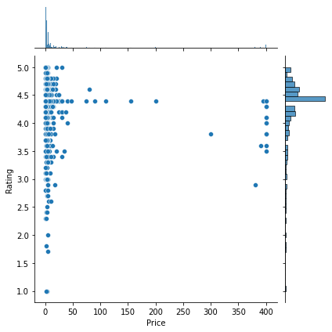
Does an app price affect it’s rating?
Here, we can observe that for high priced apps, the ratings are mostly more than 3.0.
But for free or apps with price less than 50 dollars, ratings do not usually follow any specific pattern.
They are scattered from 1 to 5. The reasons for such diverse rating pattern could be user experience or size.

Slide 22
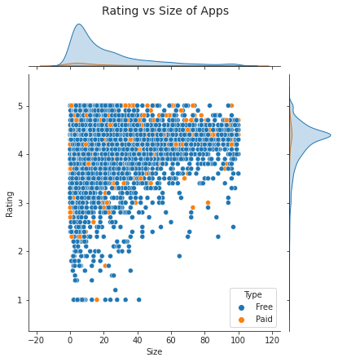
Does size of an app affect it’s rating?
People generally prefer apps with less size due to data and/size constraints. As the size of an app increases, it's rating decreases.
Surprisingly, there are few apps whose size is close to 100 MBs but still has 4/5 stars as a review. Though this number is less, we can't ignore a fact that the rating also depends upon the content that the app is serving.
Also, some of the paid apps has less ratings. So price and ratings are poorly correlated.

Slide 23
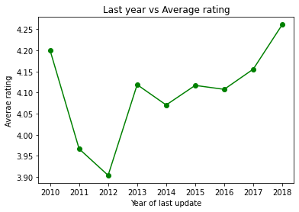
Does update of an app affect it’s rating?
We can see that the latest the update year, more are the ratings.
It is observed that from 2010 to 2011, the user experience of the apps was not good and it resulted into drastic dip in the ratings.
But from 2014, the trend got reversed. The ratings have gone up year-on-year highlighting the great user experience.

Slide 24
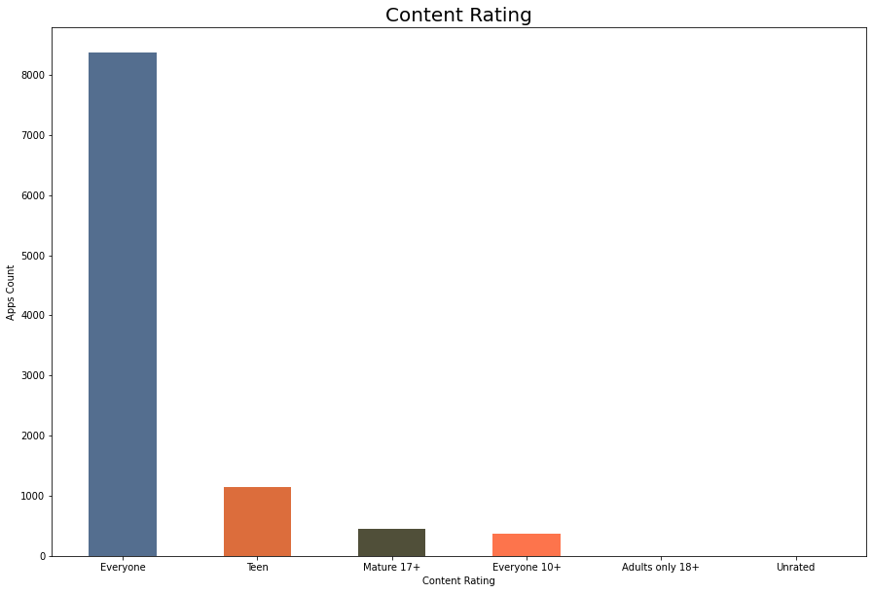

Let’s explore content rating!
Mostly 90% of total apps are targeting audience in every age group and hence they are available for everyone.
Very few(less then 500 apps) are catering to only adult population i.e. Mature 17+

Slide 25
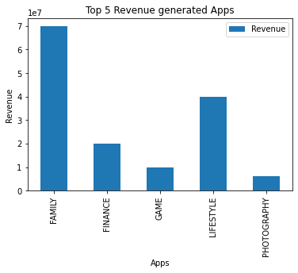
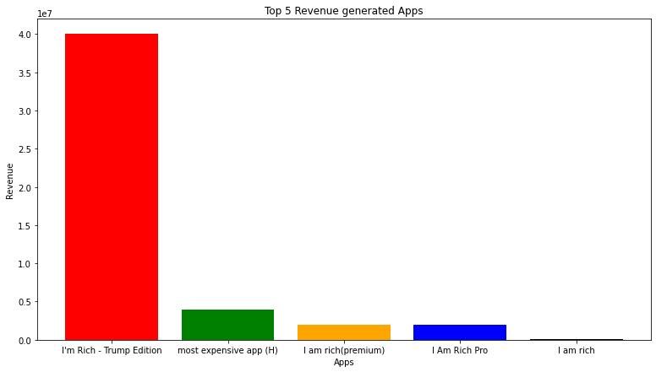
How much money the apps have generated?
We tried to utilize the information given in ‘installs’ and ‘price’, to calculate the revenue generated by apps.
The category which generated the highest revenue is FAMILY.
The app named I’m Rich-Trump Edition collected the highest money through installs.

Slide 26
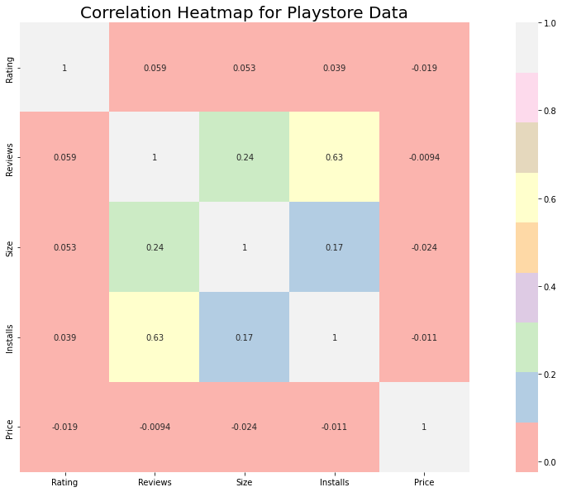
How Size, Reviews, Installs and Price of apps are correlated?
Positive correlation between the Reviews and Installs column i.e. (0.63).
While Price and Ratings share negative correlation i.e. -0.019.

Slide 27
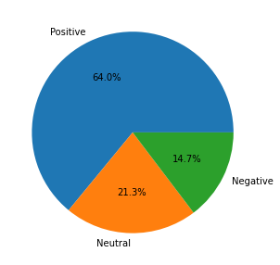
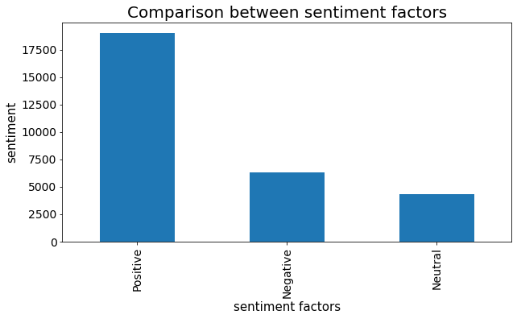
Sentiments
The sentiment plot shows the results for positive reviews as high.
We can say that around 64% of the apps on google play store have received positive sentiments by the users.
A small chunk of apps-around 14.7%-have received negative sentiments as well.

Slide 28
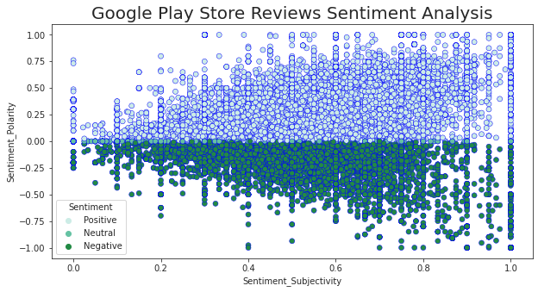
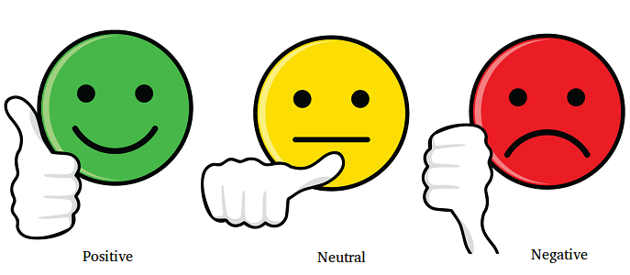
How does sentiment polarity and sentiment subjectivity are linked?
As we can observe from the above graph that sentiment subjectivity mostly lies in the range of 0.5 to 0.8. It means, people are giving reviews more opinion and experience based rather than facts.
Sentiment subjectivity is mostly scattered around - 0.5 to 0.75 this shows that polarity is not always proportional to sentiment subjectivity but in maximum number of cases it shows a proportional behavior.

Slide 29
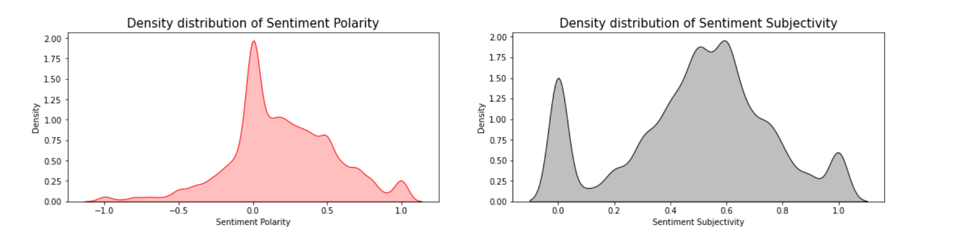
Sentiments
The polarity score lies in the range of [-1,1]. Here, we can see from our calculations and the Sentiment Polarity Density distribution graph that the Mean Sentiment Polarity Score is 0.18 which resembles a good average sentiment score(Majority of the users liking the apps).
The subjectivity is a float within the range [0.0, 1.0] where 0.0 is very objective and 1.0 is very subjective. As per our analysis and plotted graph, the Mean Sentiment Subjectivity Score is 0.49. That means around 50% users are sharing personal opinion while others 50% are just sharing the factual information in reviews.

Slide 30
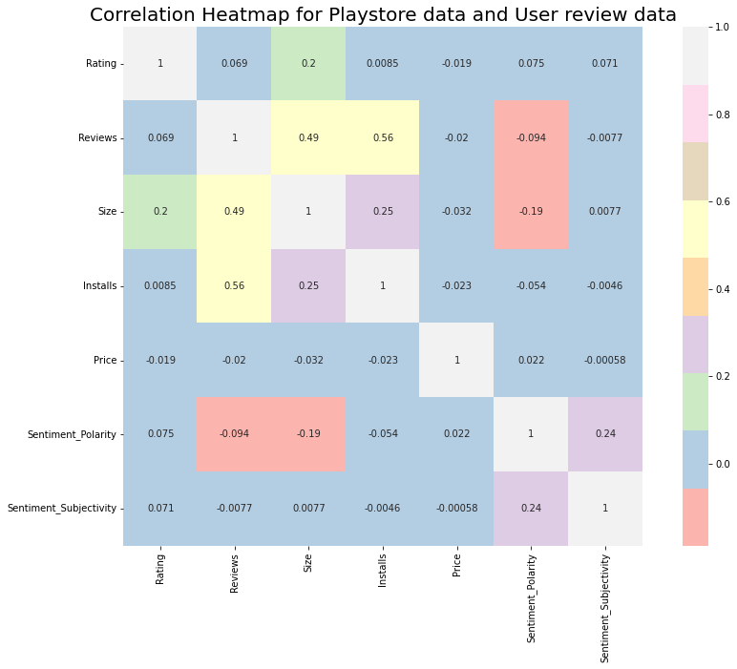
Let’s see how both the data sets are related!
Positive correlation between the Ratings and Reviews= 0.069.
Negative correlation between the Size and Sentiment Polarity = -0.19
Negative correlation between the Price and Sentiment subjectivity =
-0.00058

Slide 31

So let’s talk about the challenges that we faced:
One of the major challenge was to clean the datasets as a lot of scattered information was present especially in the 1st data set.
Handling the error, duplicate and NaN values in the dataset.
To draw meaningful insights, we had to design multiple visualizations like scatterplot, jointplot etc. without compromising the results and trends.
To overcome above challenges, we followed:
AlmaBetter Class material
Pandas and Numpy libraries
Stack overflow
YouTube
GeeksforGeeks
Analytics Vidhya

Slide 32
What did we discover?
Key factors responsible for app engagement and success are :
Price
Lower the price, More the installs!
Sentiments
Positive reviews, More the installs!
Ratings
More the ratings, More the installs!

Slide 33
Conclusions:
Reviews and installs share positive correlation while price and rating share negative correlation.
Games has the most number of installs and hence is a potential unsaturated space for all developers, as it has a maximum number of installs.
Developing apps within Family and Lifestyle categories can be aimed for more profit i.e. high revenue .
61% of people have positive sentiments while approx. 15% reacted negatively which is quite low in comparison(rest are neutral).
Compared with Free and paid apps, 92.12% apps are Free and 7.81% apps are paid.
As Everyone content rating contains all age group people , it has maximum i.e. 81.80% apps.
Maximum number of apps belong to the Family , Game and Tools category.
People love to download apps from Tools , Entertainment , Education , Business and medical genres.
Average rating of apps on the play store is 4.17 which is quite good.
Users prefer to pay for apps that are light weighted.
Paid apps that are higher in size may not perform well in the market.
Users tend to download a given app more if it has been reviewed by a large number of people.
There is a positive correlation between installs and rating.

Slide 34

Let’s do some predictions!
Now that we have analyzed out datasets and drawn meaningful insights out of them, let’s see if we can ‘predict’ a perfect app!!
It's good to develop a free app and family and lifestyle categories can be aimed for more profit.
People tend to download more if apps have more reviews.
People follow apps with timely updates having size as small as possible.
The category GAME is a potential unsaturated space for app developers. The segment is expected to grow 1.7 times faster than the rest of the market and surpass $136 billion in revenues in 2022.

Slide 35

THANK YOU

